Slide 1
Asymptotic Analysis

Slide 2
Outline
2.3
In this topic, we will look at:
Justification for analysis
Quadratic and polynomial growth
Counting machine instructions
Landau symbols
Big-Θ as an equivalence relation
Little-o as a weak ordering

Slide 3
Background
2.3
Suppose we have two algorithms, how can we tell which is better?
We could implement both algorithms, run them both
Expensive and error prone
Preferably, we should analyze them mathematically
Algorithm analysis

Slide 4
Asymptotic Analysis
2.3.1
In general, we will always analyze algorithms with respect to one or more variables
We will begin with one variable:
The number of items n currently stored in an array or other data structure
The number of items expected to be stored in an array or other data structure
The dimensions of an n × n matrix
Examples with multiple variables:
Dealing with n objects stored in m memory locations
Multiplying a k × m and an m × n matrix
Dealing with sparse matrices of size n × n with m non-zero entries

Slide 5
Maximum Value
2.3.1
For example, the time taken to find the largest object in an array of n random integers will take n operations
int find_max( int *array, int n ) {
int max = array[0];
for ( int i = 1; i < n; ++i ) {
if ( array[i] > max ) {
max = array[i];
}
}
return max;
}

Slide 6
Maximum Value
2.3.1
One comment:
In this class, we will look at both simple C++ arrays and the standard template library (STL) structures
Instead of using the built-in array, we could use the STL vector class
The vector class is closer to the C#/Java array

Slide 7
Maximum Value
2.3.1
#include <vector>
int find_max( std::vector<int> array ) {
if ( array.size() == 0 ) {
throw underflow();
}
int max = array[0];
for ( int i = 1; i < array.size(); ++i ) {
if ( array[i] > max ) {
max = array[i];
}
}
return max;
}

Slide 8
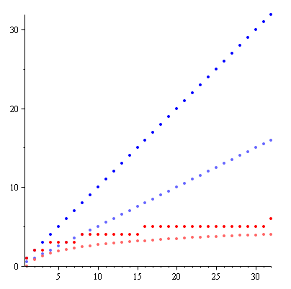
Linear and binary search
2.3.2
n
There are other algorithms which are significantly faster as the problem size increases
This plot shows maximum and average number of comparisons to find an entry in a sorted array of size n
Linear search
Binary search
Notes:
8

Slide 9
Asymptotic Analysis
2.3.3
Given an algorithm:
We need to be able to describe these values mathematically
We need a systematic means of using the description of the algorithm together with the properties of an associated data structure
We need to do this in a machine-independent way
For this, we need Landau symbols and the associated asymptotic analysis

Slide 10
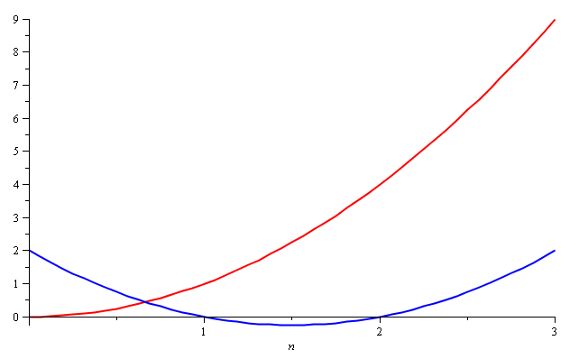
Quadratic Growth
2.3.3
Consider the two functions
f(n) = n² and g(n) = n² – 3n + 2
Around n = 0, they look very different

Slide 11
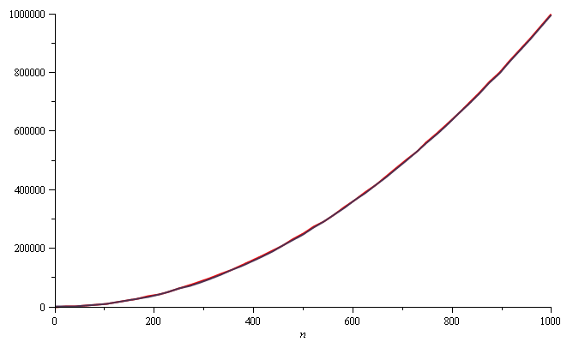
Quadratic Growth
2.3.3
Yet on the range n = [0, 1000], they are (relatively) indistinguishable:

Slide 12
Quadratic Growth
2.3.3
The absolute difference is large, for example,
f(1000) = 1 000 000
g(1000) = 997 002
but the relative difference is very small
and this difference goes to zero as n → ∞

Slide 13
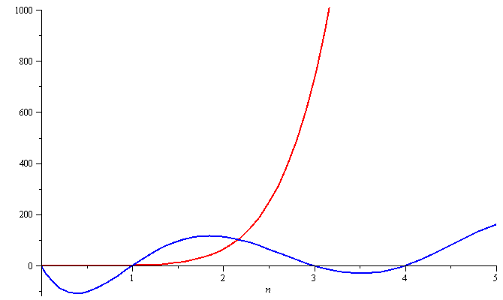
Polynomial Growth
2.3.3
To demonstrate with another example,
f(n) = n⁶ and g(n) = n⁶ – 23n⁵+193n⁴ –729n³+1206n² – 648n
Around n = 0, they are very different

Slide 14
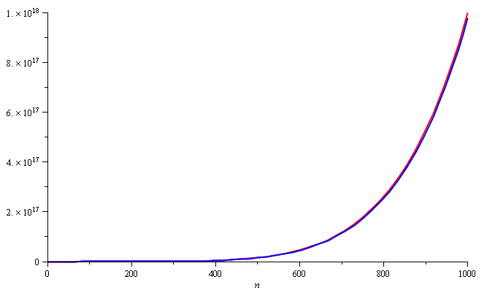
Polynomial Growth
2.3.3
Still, around n = 1000, the relative difference is less than 3%

Slide 15
Polynomial Growth
2.3.3
The justification for both pairs of polynomials being similar is that, in both cases, they each had the same leading term:
n² in the first case, n⁶ in the second
Suppose however, that the coefficients of the leading terms were different
In this case, both functions would exhibit the same rate of growth, however, one would always be proportionally larger

Slide 16
Examples
2.3.4
We will now look at two examples:
A comparison of selection sort and bubble sort
A comparison of insertion sort and quicksort

Slide 17
Counting Instructions
2.3.4.1
Suppose we had two algorithms which sorted a list of size n and the run time (in μs) is given by
b_{worst}(n) = 4.7n² – 0.5n + 5 Bubble sort
b_{best}(n) = 3.8n² + 0.5n + 5
s(n) = 4n² + 14n + 12 Selection sort
The smaller the value, the fewer instructions are run
For n ≤ 21, b_{worst}(n) < s(n)
For n ≥ 22, b_{worst}(n) > s(n)

Slide 18
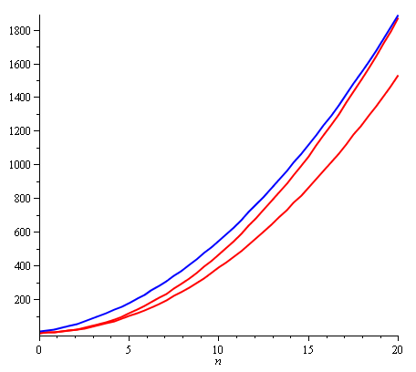
Counting Instructions
2.3.4.1
With small values of n, the algorithm described by s(n) requires more instructions than even the worst-case for bubble sort

Slide 19
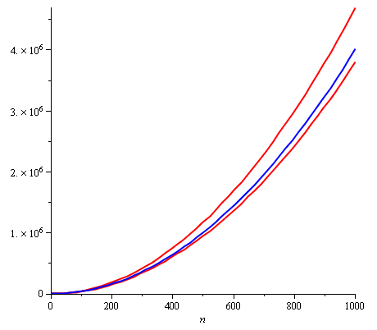
Counting Instructions
2.3.4.1
Near n = 1000, b_{worst}(n) ≈ 1.175 s(n) and b_{best}(n) ≈ 0.95 s(n)

Slide 20
Counting Instructions
2.3.4.1
Is this a serious difference between these two algorithms?
Because we can count the number instructions, we can also estimate how much time is required to run one of these algorithms on a computer

Slide 21
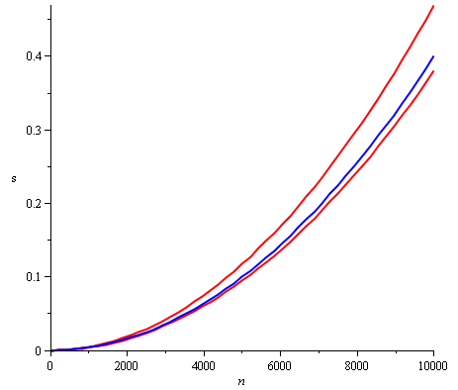
Counting Instructions
2.3.4.1
Suppose we have a 1 GHz computer
The time (s) required to sort a list of up to n = 10 000 objects is under half a second

Slide 22
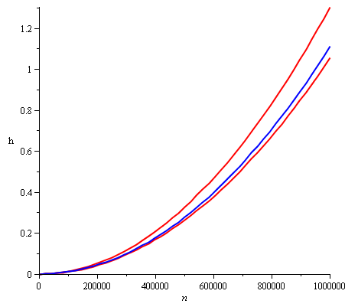
Counting Instructions
2.3.4.1
To sort a list with one million elements, it will take about 1 h
Bubble sort could, under some conditions, be 200 s faster

Slide 23
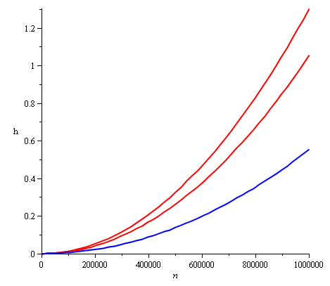
Counting Instructions
2.3.4.1
How about running selection sort on a faster computer?
For large values of n, selection sort on a faster computer will always be faster than bubble sort

Slide 24
Counting Instructions
2.3.4.1
Justification?
If f(n) = a_{k}n^{k} + ··· and g(n) = b_{k}n^{k} + ···, for large enough n, it will always be true that
f(n) < Mg(n)
where we choose
M = a_{k}/b_{k} + 1
In this case, we only need a computer which is M times faster (or slower)
Question:
Is a linear search comparable to a binary search?
Can we just run a linear search on a slower computer?

Slide 25
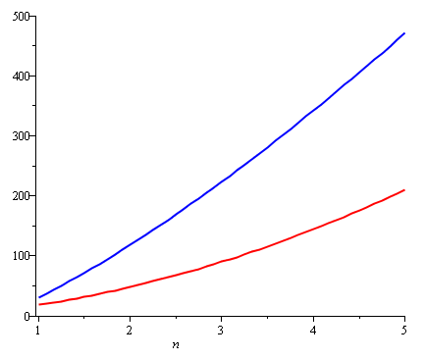
Counting Instructions
2.3.4.2
As another example:
Compare the number of instructions required for insertion sort and for quicksort
Both functions are concave up, although one more than the other

Slide 26
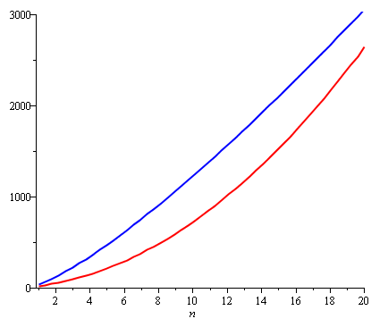
Counting Instructions
2.3.4.2
Insertion sort, however, is growing at a rate of n² while quicksort grows at a rate of n lg(n)
Never-the-less, the graphic suggests it is more useful to use insertion sort when sorting small lists—quicksort has a large overhead

Slide 27
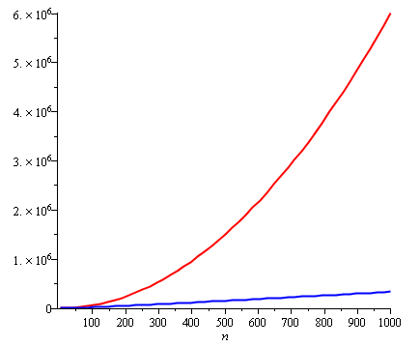
Counting Instructions
2.3.4.2
If the size of the list is too large (greater than 20), the additional overhead of quicksort quickly becomes insignificant
The quicksort algorithm becomes significantly more efficient
Question: can we just buy a faster computer?

Slide 28
Weak ordering
2.3.5
Consider the following definitions:
We will consider two functions to be equivalent, f ~ g, if
where
We will state that f < g if
For functions we are interested in, these define a weak ordering

Slide 29
Weak ordering
2.3.5
Let f(n) and g(n) describe either the run-time of two algorithms
If f(n) ~ g(n), then it is always possible to improve the performance of one function over the other by purchasing a faster computer
If f(n) < g(n), then you can never purchase a computer fast enough so that the second function always runs in less time than the first
Note that for small values of n, it may be reasonable to use an algorithm that is asymptotically more expensive, but we will consider these on a one-by-one basis

Slide 30
Weak ordering
2.3.5
In general, there are functions such that
If f(n) ~ g(n), then it is always possible to improve the performance of one function over the other by purchasing a faster computer
If f(n) < g(n), then you can never purchase a computer fast enough so that the second function always runs in less time than the first
Note that for small values of n, it may be reasonable to use an algorithm that is asymptotically more expensive, but we will consider these on a one-by-one basis

Slide 31
Landau Symbols
2.3.5
Recall Landau symbols from 1st year:
A function f(n) = O(g(n)) if there exists N and c such that
f(n) < c g(n)
whenever n > N
The function f(n) has a rate of growth no greater than that of g(n)

Slide 32
Landau Symbols
2.3.5
Before we begin, however, we will make some assumptions:
Our functions will describe the time or memory required to solve a problem of size n
We conclude we are restricting ourselves to certain functions:
They are defined for n ≥ 0
They are strictly positive for all n
In fact, f(n) > c for some value c > 0
That is, any problem requires at least one instruction and byte
They are increasing (monotonic increasing)

Slide 33
Landau Symbols
2.3.5
Another Landau symbol is Θ
A function f(n) = Θ(g(n)) if there exist positive N, c₁, and c₂ such that
c₁ g(n) < f(n) < c₂ g(n)
whenever n > N
The function f(n) has a rate of growth equal to that of g(n)

Slide 34
Landau Symbols
2.3.5
These definitions are often unnecessarily tedious
Note, however, that if f(n) and g(n) are polynomials of the same degree with positive leading coefficients:
where

Slide 35
Landau Symbols
2.3.5
Suppose that f(n) and g(n) satisfy
From the definition, this means given c > ε > 0 there
exists an N > 0 such that whenever n > N
That is,

Slide 36
Landau Symbols
2.3.5
However, the statement says that f(n) = Θ(g(n))
Note that this only goes one way:
If where , it follows that f(n) = Θ(g(n))

Slide 37
Landau Symbols
2.3.6
We have a similar definition for O:
If where , it follows that f(n) = O(g(n))
There are other possibilities we would like to describe:
If , we will say f(n) = o(g(n))
The function f(n) has a rate of growth less than that of g(n)
We would also like to describe the opposite cases:
The function f(n) has a rate of growth greater than that of g(n)
The function f(n) has a rate of growth greater than or equal to that of g(n)

Slide 38
Landau Symbols
2.3.7
We will at times use five possible descriptions

Slide 39
Landau Symbols
2.3.7
For the functions we are interested in, it can be said that
f(n) = O(g(n)) is equivalent to f(n) = Θ(g(n)) or f(n) = o(g(n))
and
f(n) = Ω(g(n)) is equivalent to f(n) = Θ(g(n)) or f(n) = ω(g(n))

Slide 40
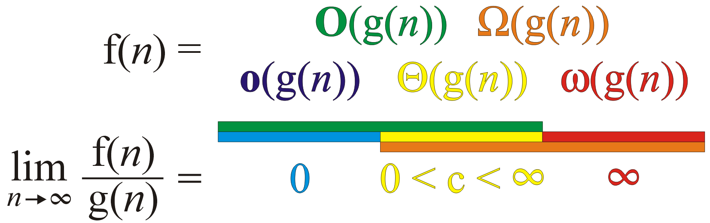
Landau Symbols
2.3.7
Graphically, we can summarize these as follows:
We say
if

Slide 41
Landau Symbols
2.3.8
Some other observations we can make are:
f(n) = Θ(g(n)) ⇔ g(n) = Θ(f(n))
f(n) = O(g(n)) ⇔ g(n) = Ω(f(n))
f(n) = o(g(n)) ⇔ g(n) = ω(f(n))

Slide 42
Big-Θ as an Equivalence Relation
2.3.8
If we look at the first relationship, we notice that f(n) = Θ(g(n)) seems to describe an equivalence relation:
1. f(n) = Θ(g(n)) if and only if g(n) = Θ(f(n))
2. f(n) = Θ(f(n))
3. If f(n) = Θ(g(n)) and g(n) = Θ(h(n)), it follows that f(n) = Θ(h(n))
Consequently, we can group all functions into equivalence classes, where all functions within one class are big-theta Θ of each other

Slide 43
Big-Θ as an Equivalence Relation
2.3.8
For example, all of
n² 100000 n² – 4 n + 19 n² + 1000000
323 n² – 4 n ln(n) + 43 n + 10 42n² + 32
n² + 61 n ln²(n) + 7n + 14 ln³(n) + ln(n)
are big-Θ of each other
E.g., 42n² + 32 = Θ( 323 n² – 4 n ln(n) + 43 n + 10 )

Slide 44
Big-Θ as an Equivalence Relation
2.3.8
Recall that with the equivalence class of all 19-year olds, we only had to pick one such student?
Similarly, we will select just one element to represent the entire class of these functions: n²
We could chose any function, but this is the simplest

Slide 45
Big-Θ as an Equivalence Relation
2.3.8
The most common classes are given names:
Θ(1) constant
Θ(ln(n)) logarithmic
Θ(n) linear
Θ(n ln(n)) “n log n”
Θ(n²) quadratic
Θ(n³) cubic
2^{n}, e^{n}, 4^{n}, ... exponential

Slide 46
Logarithms and Exponentials
2.3.8
Recall that all logarithms are scalar multiples of each other
Therefore log_{b}(n)= Θ(ln(n)) for any base b
Alternatively, there is no single equivalence class for exponential functions:
If 1 < a < b,
Therefore a^{n} = o(b^{n})
However, we will see that it is almost universally undesirable to have an exponentially growing function!

Slide 47
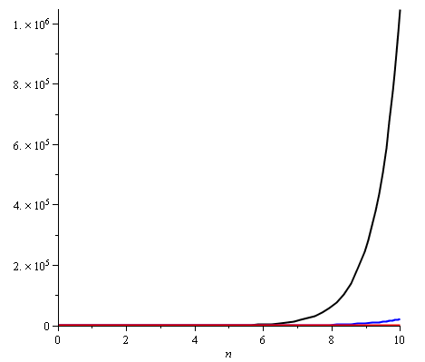
Logarithms and Exponentials
2.3.8
Plotting 2^{n}, e^{n}, and 4^{n} on the range [1, 10] already shows how significantly different the functions grow
Note:
2¹⁰ = 1024
e¹⁰ ≈ 22 026
4¹⁰ = 1 048 576

Slide 48
Little-o as a Weak Ordering
2.3.9
We can show that, for example
ln( n ) = o( n^{p} )
for any p > 0
Proof: Using l’Hôpital’s rule, we have
Conversely, 1 = o(ln( n ))

Slide 49
Little-o as a Weak Ordering
2.3.9
Other observations:
If p and q are real positive numbers where p < q, it follows that
n^{p} = o(n^{q})
For example, matrix-matrix multiplication is Θ(n³) but a refined algorithm is Θ(n^{lg(7)}) where lg(7) ≈ 2.81
Also, n^{p} = o(ln(n)n^{p}), but ln(n)n^{p} = o(n^{q})
n^{p} has a slower rate of growth than ln(n)n^{p}, but
ln(n)n^{p} has a slower rate of growth than n^{q} for p < q

Slide 50
Little-o as a Weak Ordering
2.3.9
If we restrict ourselves to functions f(n) which are Θ(n^{p}) and Θ(ln(n)n^{p}), we note:
It is never true that f(n) = o(f(n))
If f(n) ≠ Θ(g(n)), it follows that either
f(n) = o(g(n)) or g(n) = o(f(n))
If f(n) = o(g(n)) and g(n) = o(h(n)), it follows that f(n) = o(h(n))
This defines a weak ordering!

Slide 51
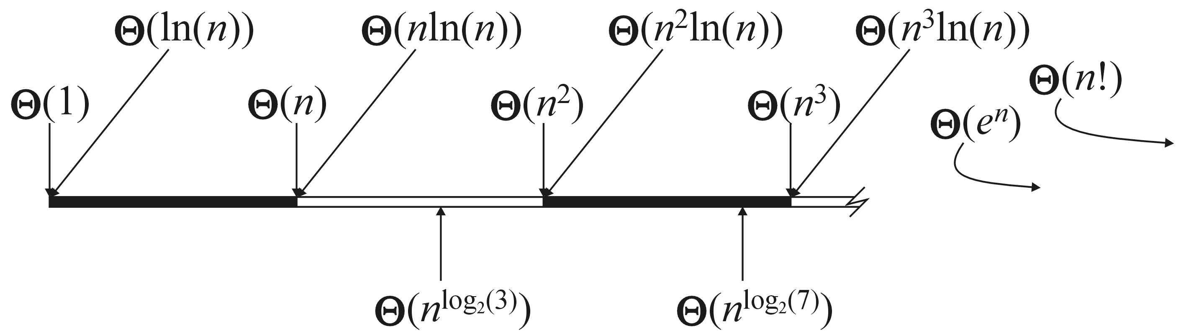
Little-o as a Weak Ordering
2.3.9
Graphically, we can shown this relationship by marking these against the real line

Slide 52
Algorithms Analysis
2.3.10
We will use Landau symbols to describe the complexity of algorithms
E.g., adding a list of n doubles will be said to be a Θ(n) algorithm
An algorithm is said to have polynomial time complexity if its run-time may be described by O(n^{d}) for some fixed d ≥ 0
We will consider such algorithms to be efficient
Problems that have no known polynomial-time algorithms are said to be intractable
Traveling salesman problem: find the shortest path that visits n cities
Best run time: Θ(n² 2^{n})

Slide 53
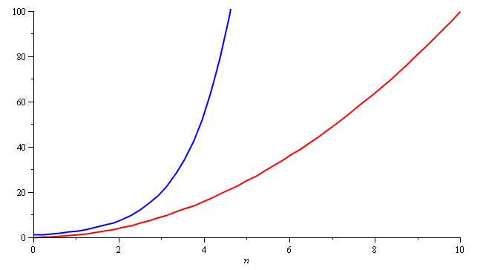
Algorithm Analysis
2.3.10
In general, you don’t want to implement exponential-time or exponential-memory algorithms
Warning: don’t call a quadratic curve “exponential”, either...please

Slide 54
Summary
In this class, we have:
Reviewed Landau symbols, introducing some new ones: o O Θ Ω ω
Discussed how to use these
Looked at the equivalence relations

Slide 55
References
Wikipedia, https://en.wikipedia.org/wiki/Mathematical_induction
These slides are provided for the ECE 250 Algorithms and Data Structures course. The material in it reflects Douglas W. Harder’s best judgment in light of the information available to him at the time of preparation. Any reliance on these course slides by any party for any other purpose are the responsibility of such parties. Douglas W. Harder accepts no responsibility for damages, if any, suffered by any party as a result of decisions made or actions based on these course slides for any other purpose than that for which it was intended.

